Slide 1

Pen-Based Recognition of Handwritten Digits Data Set
Hema Bahirwani
Navneet Sinha
Vatsala Singh

Slide 2

Objective
Classify digitally written digits on a tablet as input into [0-9] classes.
Comparative study of 4 different classification algorithms, namely:
Multinomial Logistic Regression.
Decision Trees.
Random Forest.
Multilayer Perceptron.
The four models are then combined to a single classifier called by an ensemble method called Stacked Generalization.

Slide 3
Business Understanding
Understanding the data and decide how to split the data for our use
Comparative analysis of four different classification models.
Selection of error based measurement statistic.

Slide 4
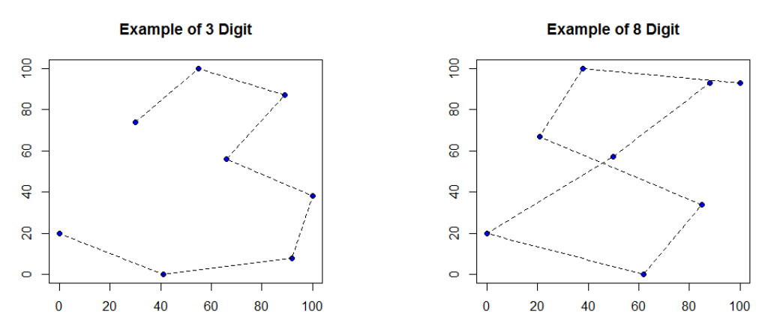
Data Understanding
Ref: http://cs229.stanford.edu/proj2013/AragonLaneZhang-ClassifyHandWrittenNumericDigits.pdf

Slide 5
Data Understanding
250 Samples from 44 Writers.
30 out of 44 writers’ samples to be used for training and validation.
Remaining 14 is for independent study.
X and Y coordinates of the digit recorded are being considered for the task.
Dataset Broken down into 7494 samples for training and 3498 for testing.
Dataset Distribution
Training | Test | Attributes | Class Attribute | Missing Values
7494 | 3498 | 16 | 1 | 0

Slide 6
Data Understanding
Training Data Per Class Instance Distribution
Class Label | Instances | Class Label | Instances
0 | 780 | 5 | 720
1 | 779 | 6 | 720
2 | 780 | 7 | 778
3 | 719 | 8 | 719
4 | 780 | 9 | 719

Slide 7
Ethical Issues
Dataset is publicly available on UCI Machine Learning Repository.
Writers were aware of the experiment.
They gave their consent to use this data publicly.
So we face no ethical challenges with this dataset.
Ref: https://archive.ics.uci.edu/ml/datasets/Pen-Based+Recognition+of+Handwritten+Digits

Slide 8
Data Preparation
Normalized the data to make it scale and translation invariant. [0-500] changed to [0-100]
Resampled data using simple linear interpolation.
The data is then split in the ratio of 80:20 for training.
Splitting the data and never training on the test data helps remove bias, and also prevents overfitting.

Slide 9
Modeling
We implemented and evaluated four different model Machine Learning classification models to perform the prediction of pen-based handwritten digits.
Multinomial Logistic Regression: It is a generalized form of Logistic Regression which can be used for dataset which has more than two number of classes unlike Logistic Regression which can only be used for a binary classification
Decision Tree: It is supervised algorithm which is based on a tree like structure consisting of nodes and branches with each non-leaf node in the tree depicting a test, that is, an if-then rule for a given attribute.

Slide 10
Modeling
Random Forest: It is a supervised algorithm consisting of multiple decision trees which output a class and by a voting algorithm, majority class is chosen as a final prediction of Random Forest Classifier
Multi-Layer Perceptron: It is feed forward artificial neural network which falls in the category of supervised learning algorithms. It can have multiple layers to feed the input and output the prediction. Our model consists of total 7 layers, in which 5 are hidden layers with 80 hidden input units, one input layer and one output layer.
Stacked Generalization: It is an ensemble learning classification algorithm which combines the results of multiple base classifiers to train on new classifier and make the final prediction.

Slide 11
Results
Multi-Layer Perceptron gives the highest accuracy of 98.02%, out of all the models.
The table below shows the accuracies of the four models implemented.
Multi-Layer Perceptron | 98.02%
Random Forest | 96.34%
Decision Tree | 91.4%
Multinomial Logistic Regression | 89.05%

Slide 12
Results continued..
Confusion matrices produced by all the four models are shown in the research report attached.
We also explored and evaluated the Stacked Generalization which didn’t provide significant results.

Slide 13
Future Work
With more data, the accuracies of the model can be increased further.
Also, the final model can be deployed in a mobile application which would predict the digits written by the user on the phone using a smartpen.

Slide 14
Thank you

